Slide 1
CSC-350 Topics in Computer Science Spring 2024
Week 2
Dr. Farhan Aadil
farhan.aadil@ciit-attock.edu.pk
DrAadil.com
Please turn OFF your Mobile Phones!

Slide 2
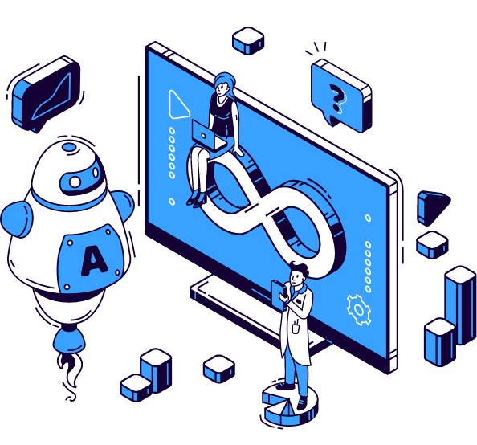

DevOps
Automation Everything You
Need to Know
Dr. Farhan Aadil
CS Department, CUI Attock

Slide 3


DevOps Trends in 2024
3.DevSecOps will become a default part of DevOps
2.Focus on Edge-
Computing
4.Migration
to Serverless Architecture
1.Becoming
Cloud-Centric
5.DevOps Automation
Source:
https://www.weblineindia.com/blog/all-about-devops-automation/

Slide 4
DevSecOps

Slide 5
Software Development Assembly Line
$$
$$$
$$$$
$
Plan
Code
Test
Release
Package
Deploy
Operate
Monitor
Dev
Ops
Lower Costs by fixing Defects earlier
Notes:
Regardless of what development methodology is used – Agile, XP, Waterfall, Agile-fall – the process is pretty much the same over short or long sprints.
Find defects in production that are the costliest to fix, and it’s less expensive the earlier you can catch the defect.

Slide 6
Security Assessment in Software Process
$$$$
$$$$
$
$$
$$$
Plan
Code
Test
Release
Package
Deploy
Operate
Monitor
Dev
Ops
Security
Notes:
If you apply this same model to security issues, it’s costly to fix them in production as it requires patching software or changing application code that might break the application. Who will pay for this? It’s one thing to fix a functional defect, the business owner will want their app to work properly, but what’s the reaction if you tell them that there is a Severity 5 vulnerability in Java 1.8.0.1 that allows for a remote code execution exploit. Huh?
It’s probably more expensive to fix security issues in production rather than functional defects in production. If you have to patch Apache or Java or some rare networking library, the entire application needs to be thoroughly tested. That’s much more involved and costs event more than say fixing a single defect in an isolated feature from a functional point of view.

Slide 7
Where do Security Assessments fit ?
Plan
Code
Test
Release
Package
Deploy
Operate
Monitor
Dev
Ops
Security
Security
Notes:
Regardless if this is Waterfall or an Agile sprint, security usually can assess at two points in time. A small effort near the end of the testing or staging phase to catch “critical issues” before production, and a second larger assessments on production systems often weekly or monthly. This does not support the point that security is integrated into the DevOps process, and more importantly, security findings that need to be fixed are presented after the development project has completed.

Slide 8
Terminology: Shift Left
“Improve quality and reduce downstream disruptions by moving testing earlier in the software development lifecycle.”
Shift Left aligns with Agile Development
Do more earlier where it’s cheaper + more effective
Continuous development/testing
Feedback loops to improve
Notes:
Shift Left is being used by software development to improve quality in development projects. Agile shows that by creating multiple sprint throughout the development project such that more is done earlier in the process.
One could wonder: if it’s good enough for Development to “Shift Left”, how can I apply this to Security?

Slide 9
Apply Shift Left to Security ?
Plan
Code
Test
Release
Package
Deploy
Operate
Monitor
Dev
Ops
Security
Security
Security
Security
Notes:
The natural inclination is to do more of the same things but earlier in the development cycle.
Unfortunately, if the security tools are not integrated into developer tools, processes, and workflow, this creates barriers, gates, slowdowns, and disrupts the development process.
Doing the same things earlier more than likely makes the security teams a Foe of development, not a Friend.

Slide 10


DevOps + Security: Friend or Foe?
Source: https://theclumpany.wordpress.com/2015/08/09/pitchforks-and-flaming-torches/
Notes:
You don’t want to have a negative backlash from your developer users, and you don’t want to be left on the side of the road.
You need to take a different approach.

Slide 11
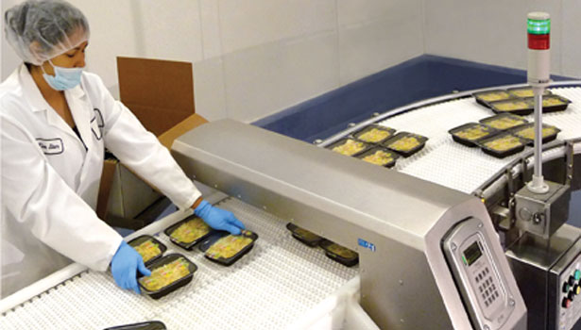
Transparent Security or Process Blockers
Does anyone know what this is? An X-ray scanner to make sure that processed food doesn’t contain any metal.
Note from here that the defect checking is part of the process, it just sits on top of the conveyor belt. Would a factory accept a process in which all product needs to be removed from the conveyor, moved to a table, scanned one at a time, and put back on the belt?
No, they wouldn’t. This applies to introducing security into DevOps, too, as we discussed previously.
Notes:
Source: http://www.foodengineeringmag.com/articles/88990-tech-update-metal-detection-xray-inspection-

Slide 12
Integrate Security into the CI/CD Process
Plan
Code
Test
Release
Package
Deploy
Operate
Monitor
Dev
Ops
Continuous Integrated Security
Audit
DevSecOps
Notes:
Instead of point-in-time security, integrate continuous security through the entire DevOps and CI/CD processes. Provide tools and integrations that make it seamless to developer and operations users.
Then the assessment that is performed in production is less about assessing the entire process, but rather looking for net new security issues that have occurred since the deploy to production, like new vulnerability disclosures.

Slide 13
Shift Left Security – Continuous Security
Plan
Code
Test
Release
Package
Deploy
Operate
Monitor
Dev
Ops
Continuous Integrated Security
Secure SDLC
Training
Static Code Analysis
Dynamic App Sec Testing
Build / Policy Compliance
Vulnerability
Assessment
Policy Compliance
Dynamic App Sec Testing
Audit
Vulnerability
Assessment
Vulnerability
Assessment
Notes:
Some examples of applying continuous security throughout the DevOps process include the following. Some are still point in time, but has taken more of a prominence because security overall is a first-class citizen to the process.
Other security functions like vulnerability assessment, dynamic application security testing, and compliance checks are continuously verified throughout the entire end-to-end cycle.
Security can Shift Left by doing more earlier before costly security mistakes are released to production, and by integrating security into the IT and Application infrastructures, it’s easy for DevOps to use.

Slide 14
DevSecOps – How to Accelerate Usage
Security built into the foundational layers
Security as Code
Security delivered as a Service
Integration with DevOps tools and processes
Same security tools set for Development and Production
Same security tools across cloud, on-premise, hybrid
Same security tools for operational and compliance / audit findings
Notes:
There are many considerations in how you can accelerate usage of security within DevOps. I’ll give examples of each one.

Slide 15
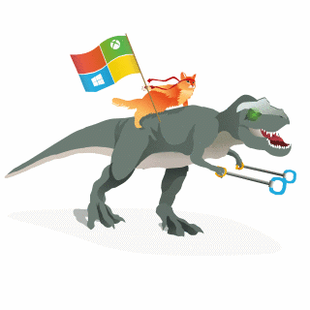



Happy DevOps
DEV
OPS
Production

Slide 16
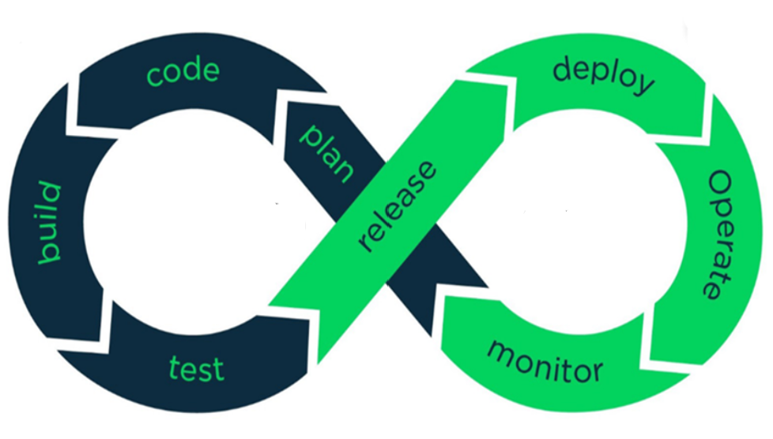
Development
Operations
Notes:
Graphic: https://www.brainvire.com/devops/ (with modifications from AFIT)
DEV/OPS uses automation and monitoring of short dev cycles, frequent deployments and aligns with business operations

Slide 17




How do we implement all these things??

Slide 18
DevOps Technical Strategy
Approach
Phase I
1
Build a CI/CD Pipeline to Automate Build and Deployment
Phase II
2
Containerize Apps
Use App Containers to Build Environments
Deploy to Containers as though they were servers
Phase III
3
Build Containers within the CI/CD Pipeline
Deploy Containers to Environments through and Orchestrated Delivery Platform
Implement a microservices strategy

Slide 19
DevOps Principles Overview
DevOps
Agile embraces continuous change, DevOps embraces continuous test/integration/delivery/deployment
How? Break down the silos sub teams (Dev, Ops, Test, Q/A). Everyone becomes a first-class citizen.
Principles
Collaboration
Use tools that influence collaboration (within and between teams), enforce policy
Infrastructure as Code (IaC)
entire environment (servers/links/platforms/apps/configuration) all represented as scripts stored in version control
Tools: Open stack (Heat), AWS (Cloud Formation), Docker, Chef, Puppet, Vagrant
Automation
Script as much manual processing as possible!
Continuous Integration/Test/Delivery/Deployment
Tools: Jenkins/Team City/AWS DevOps, Docker
Monitoring:
Cloud watch (AWS), Ceilometer (Openstack), VictorOPs

Slide 20
DevOps Core Principles (Explaination)
Collaboration
Efficiency (communication and processes) between disparate roles, both within teams between teams in an organizations
Infrastructure as Code (IaC)
Script and version control as much of infrastructure as possible, principally for capturing the disparate environment details (.e.g. development, testing, production, etc.)
Goal: (repeatable, recoverable, reusable, sharable)
Automation
Automate human (error processes) wherever possible
Goal: Increase frequency of testing, continuous (consistent/uniform) integration, delivery, and deployment processes
Monitoring
Data to needed to inform development/operational decisions
policies and priorities are domain dependent
Is the System working? Performance? Are users consuming the system as expected

Slide 21
Parity: Automate (Standardize) Processes
Integration: merging disparate system artifacts is challenging
Often done manually – (slow and error prone) == complex and expensive
Can’t automate everything, but … big changes have security implications that require review etc.)
Continuous Integration (automate what makes sense…)
Automate/standardize submission process (get artifacts) into the various environments (testing, staging…)
Greater visibility: everybody gets notified of issue(s) sooner: developers, testers (QA), Op (Security), Management, etc.
fail fast and fix fast == increase efficiency.
Continuous Delivery
Changes pushed often to customer/mock production environment
perhaps staging is configured as such)
Give everybody (customer/stakeholders) visibility
Continuous Deployment
Changes are pushed continuously (often) into production
Domain specific
doesn’t mean this makes sense
does mean the process for deployment is automated, consistent, reliable, and repeatable.
*Goal Process/Environment Parity to achieve frequent/regular testing
Make small, incremental changes

Slide 22
Tools that support/enable DevOps
Not a single tool (cross-functional concerns)
multiple tools (tool chains) that fit into one or more categories reflective of the development and delivery process…
Code – code development and review, source code management tools, code merging
Build – continuous integration tools, build status
Test – continuous testing tools that provide feedback on business risks
Package – artifact repository, application pre-deployment staging
Release – change management, release approvals, release automation
Configure – infrastructure configuration and management, infrastructure as code tools
Monitor – applications performance monitoring, end-user experience [3]

Slide 23
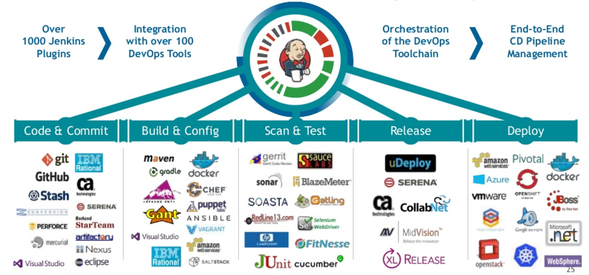
DevOps Toolbox
https://hostadvice.com/blog/devops-toolbox-jenkins-ansible-chef-puppet-vagrant-saltstack/

Slide 24
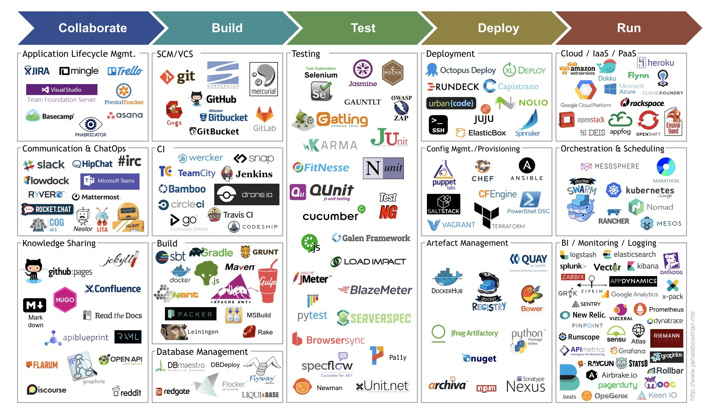
https://devopedia.org/devops
Ultimate DevOps Tool list # 1

Slide 25
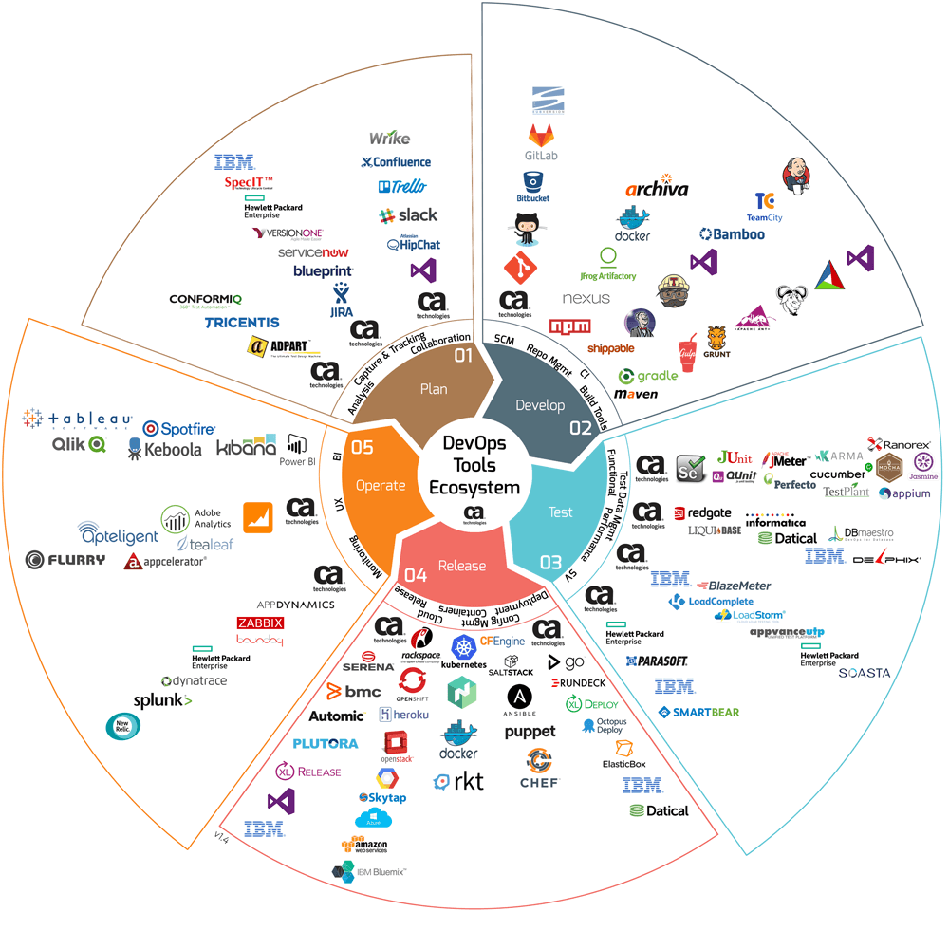
https://goo.gl/images/zH2Pys
Ultimate DevOps Tool list # 2

Slide 26
What is a Container? “Containerization”

Slide 27
Containers & Kubernetes Starting with the basics

Slide 28
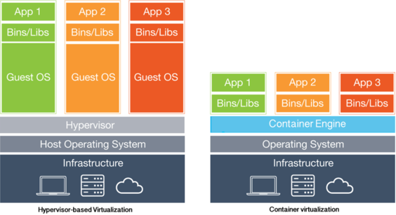
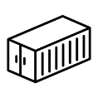

Let’s start with some basics….
What are Containers?
Not new; available since 2004; but now more versatile
“It is a solution to the problem of how to get App/Software to run reliably when moved from one computing environment to another”
Examples of discrete environments it can handle - Test Vs Prod; Phy vs Virtual Machines
Container = (App + All its dependencies) in a box
Virtualization vs Containerization?
Virtual Machine = (Apps + Run Time + OS) orchestrated by a Hypervisor
Container = (Apps + Bins/Libs + Run Time) on a Shared OS managed through a Container Engine
28

Slide 30
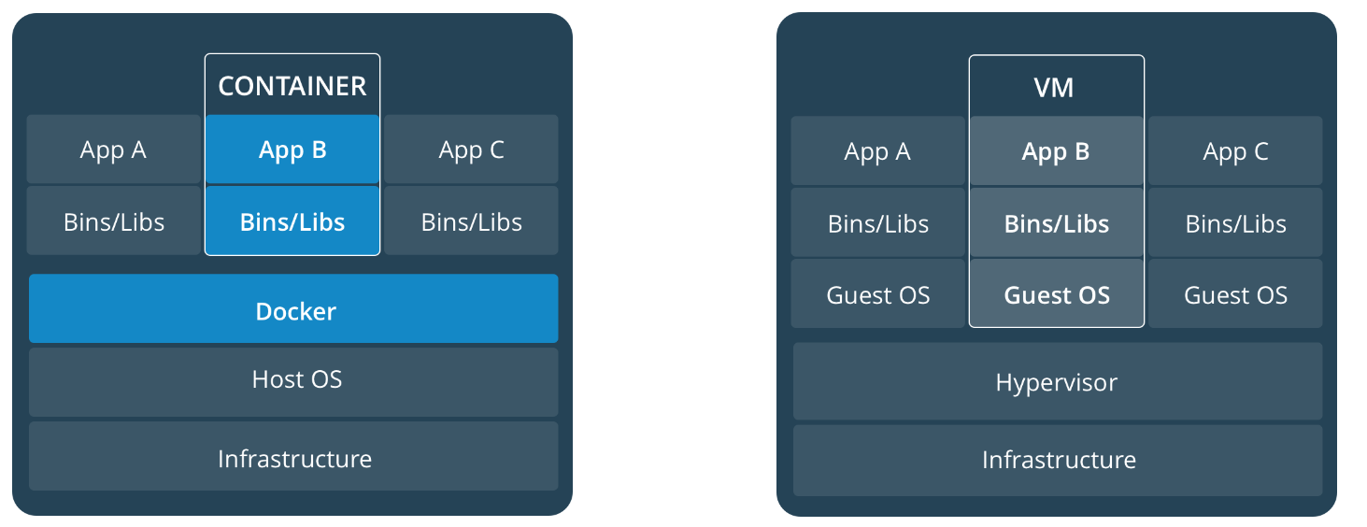
Container is not a Virtual machine!
https://docs.docker.com/get-started/#images-and-containers

Slide 31
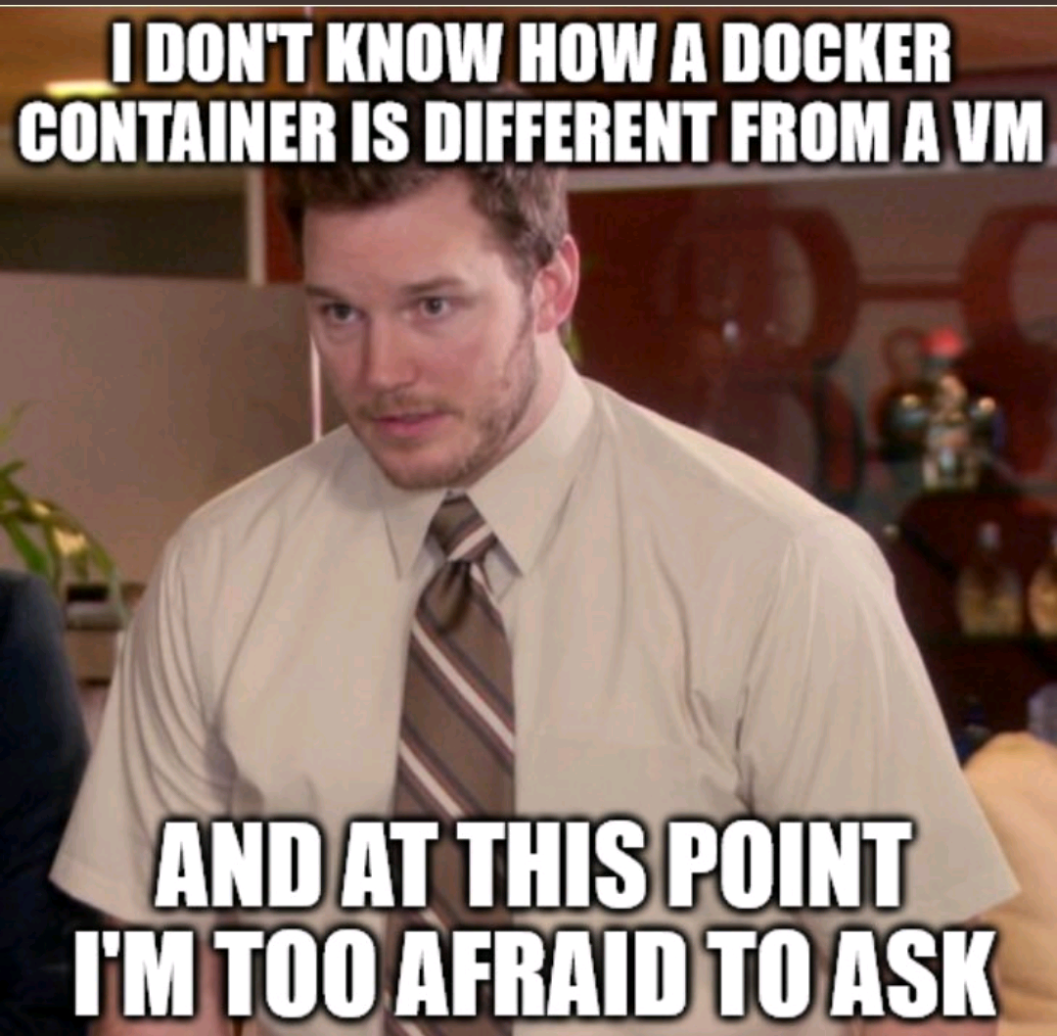

Slide 32
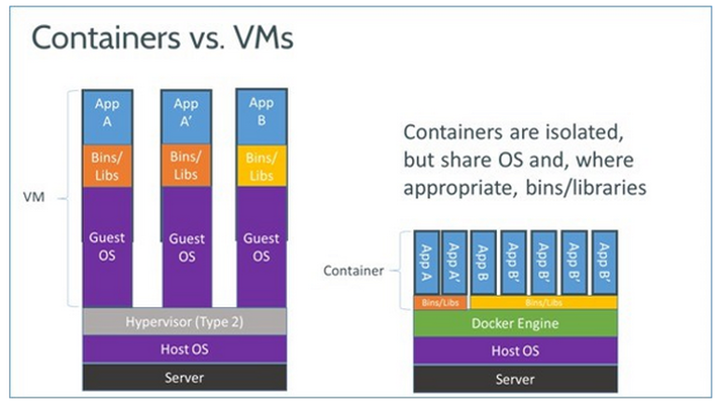
https://goo.gl/images/FCgPFY

Slide 33


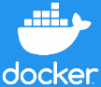
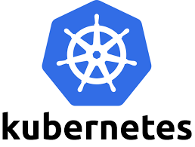
And get deeper into the concepts…
What is Kubernetes (K8s) or Kubernetes Cluster?
Container Orchestration Platform
Schedules, Replaces, Scales-up and Scales-down Containerized Apps
Helps in Availability, Scalability, Reliability and Resiliency
What are prominent Container Engines & Container Orchestration Systems?
Container Engines:-
Docker Platform (Created by Docker Inc). (Docker is interchangeably used with Containers)
Amazon Elastic Container Service (Amazon ECS) / Azure Container Service
Container Orchestration
Kubernetes Engine (also denoted as K8s)
AWS EKS (Elastic Kubernetes Service) / Azure Kubernetes Service (AKS)
https://labs.play-with-k8s.com/
33

Slide 34


And a little more…
What is CNCF?
Cloud-Native Computing Foundation*
Parent Organization: Linux Foundation
Founding Members: Google, RedHat, Cisco, IBM, Docker, VMWare
What is DevOps & DevOps Tool Chains?
DevOps = Software Development + IT Operations
DevOps Lifecycle - 7 stages- “Continuous” Development, Integration, Testing, Monitoring, Feedback, Deployment & Operations
Continuous Integration (CI/CD) includes - Commit, Build, Test, Stage, Deploy Dev/QA, Deploy Prod
Prominent Tool Chains (there are many more; refer to forthcoming slides):
Collaboration, Commit, Build - Jira
CI/CD - Jenkins
Testing - Selenium
Code Repositories - BitBucket, GitLab
Versioning Tools - Apache Subversion (SVN)
34

Slide 35
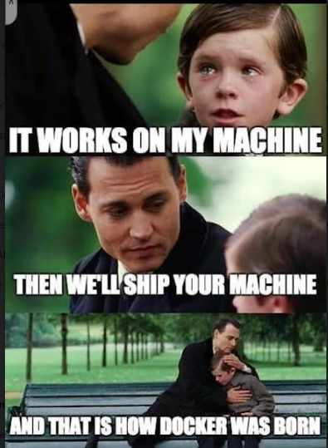

Slide 36

What is Docker?
An open platform developing, shipping and running applications using container technology
ship, testing, and deploy code quickly
reduce the time between code development and running in production.
Docker Engine is a client-server application with these major components:
A server which is a type of long-running program called a daemon process (the dockerd command)
A REST API which specifies interfaces that programs can use to talk to the daemon and instruct it what to do.
A command line interface (CLI) client (the docker command).
Registry (Docker Hub)
https://docs.docker.com/engine/docker-overview/

Slide 37
Benefits and Risks
Benefits
Flexible: Even the most complex applications can be containerized.
Lightweight: Containers leverage and share the host kernel.
Interchangeable: You can deploy updates and upgrades on-the-fly.
Portable: You can build locally, deploy to the cloud, and run anywhere.
Scalable: You can increase and automatically distribute container replicas.
Stackable: You can stack services vertically and on-the-fly.
Risks -> Security is the big one
Subject of ongoing discussion..
Docker Engine (daemon itself), registry (.e.g. docker hub), intrinsic security of the kernel
Limited ability to reason effectively across abstraction boundaries
https://docs.docker.com/get-started/
https://docs.docker.com/engine/security/security/

Slide 38
DevOps for AI Development
Can be used to manage pain points
Integration between data scientists and software engineers
Scripts stored on one person's machine and process are not repeatable by anyone else
Model versioning based on names, hard to know where model is deployed
Accuracy of model is determined during training and might change over time because of the data drift
Determine the value of the trained model, decide if it should be deployed

Slide 39
Model Lifecycle Management

Slide 40
Building your own AI models
Transforming data into intelligence
Prepare data
Build and train
Deploy

Slide 41
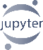

Data science workflow
Prepare
Experiment
Deploy
…
Prepare Data
Build model (your favorite IDE)
Train & Test Model
Register and Manage Model
Build Image
Deploy Service
Monitor Model
Notes:
Here is the data scientist’s inner loop of work

Slide 42
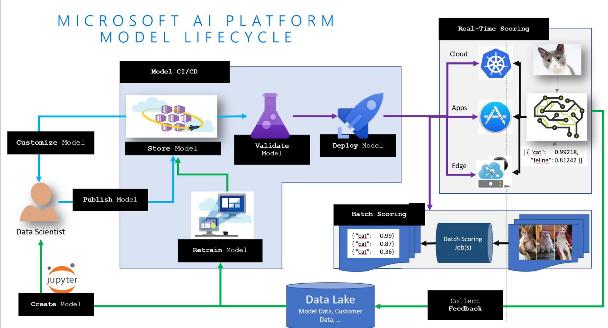
Model Lifecycle

Slide 43
What does DevOps for AI mean?

Slide 44
Produce Repeatable Experiments
80%
75%
90%
85%
Use well-defined pipelines to capture the E2E model training process
Capture run metrics, intermediate outputs, output logs and models
Use leaderboards, side by side run comparison and model selection
No matter where an experiment happens, track it in the cloud so you can explain how a model was created.

Slide 45
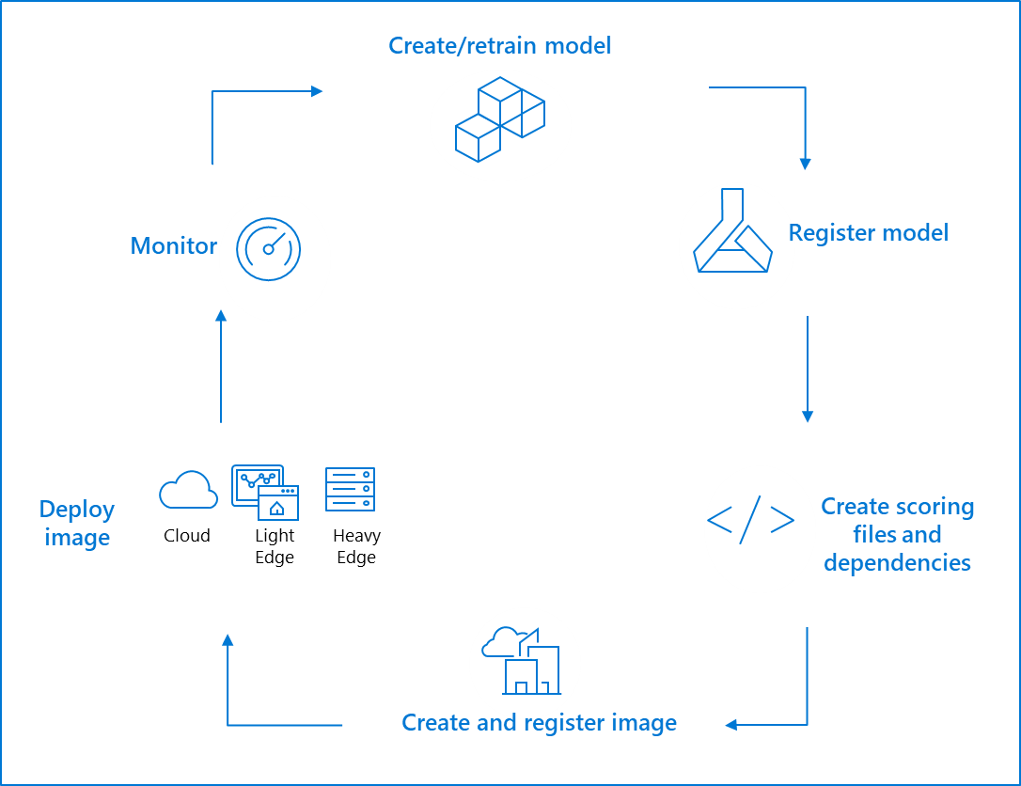
Manage Model Lifecycle
Track model versions & metadata with a centralized model registry
Leverage containers to capture runtime dependencies for inference
Leverage an orchestrator like Kubernetes to provide scalable inference for your real time services (scale / load balancing)
Capture model telemetry – health, performance, inputs / outputs
Encapsulate each step in the lifecycle to enable CI/CD and DevOps
Automatically optimize models to take advantage of hardware acceleration

Slide 46
Key Goals of DevOps for AI
Repeatability of model creation & behavior
Evaluation of model predictions
Managing different model versions and files
Operationalization of the model
Monitoring of training and scoring pipelines

Slide 47
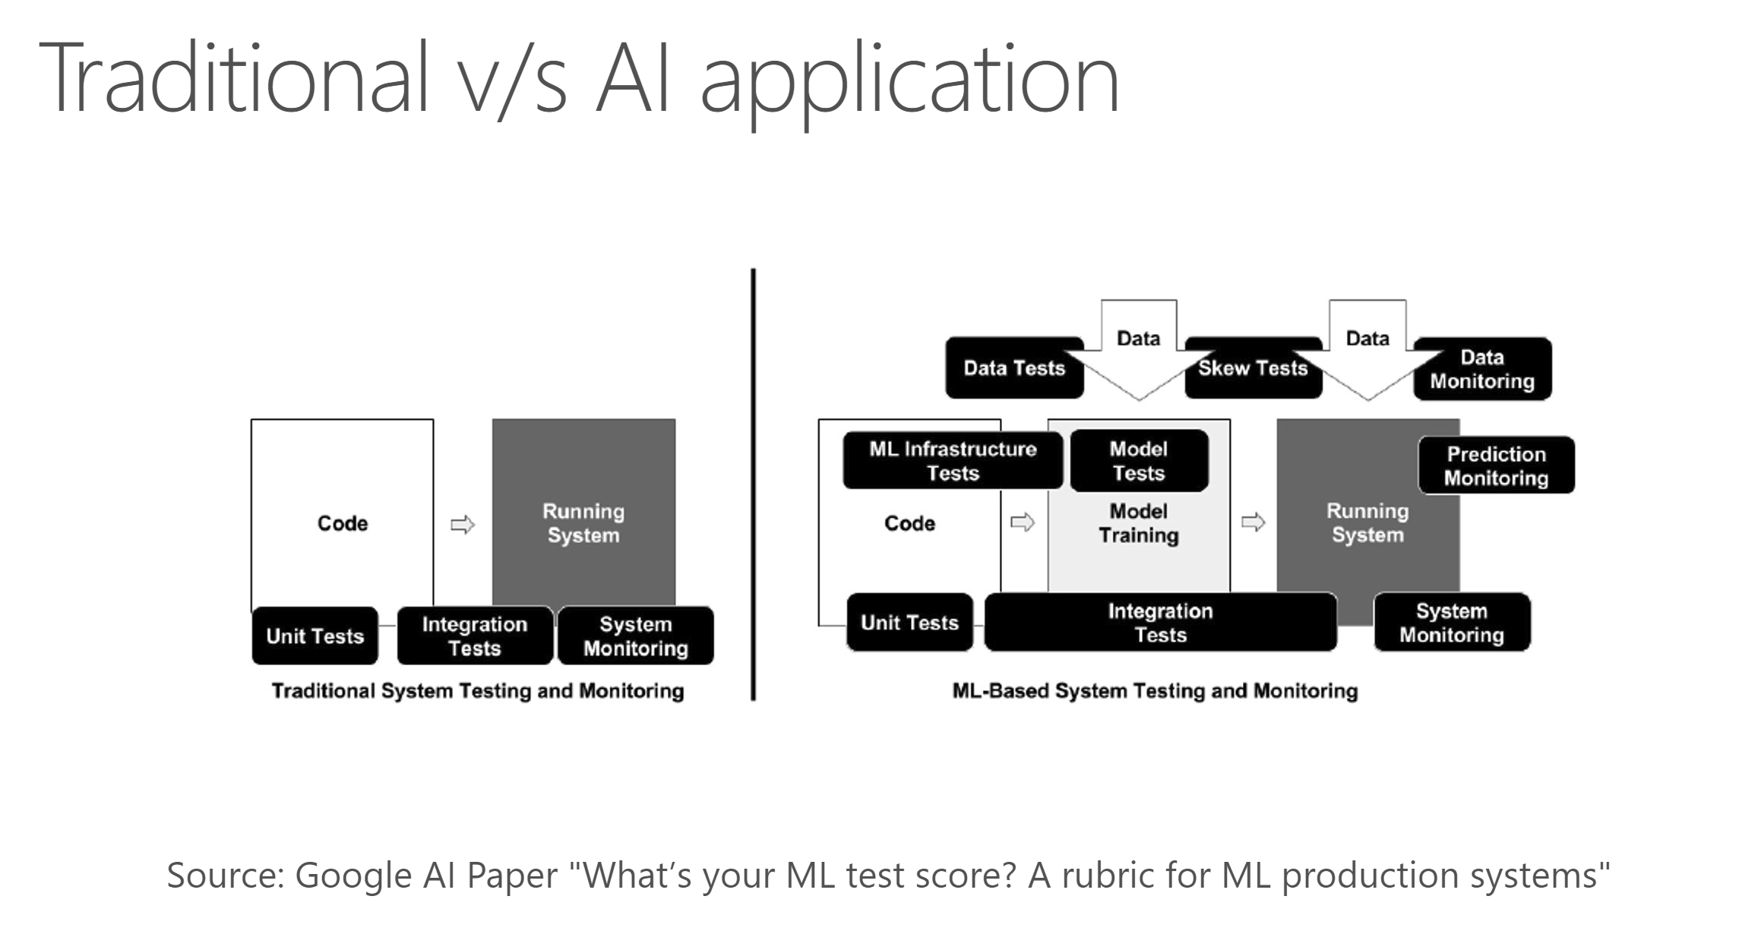

Slide 48
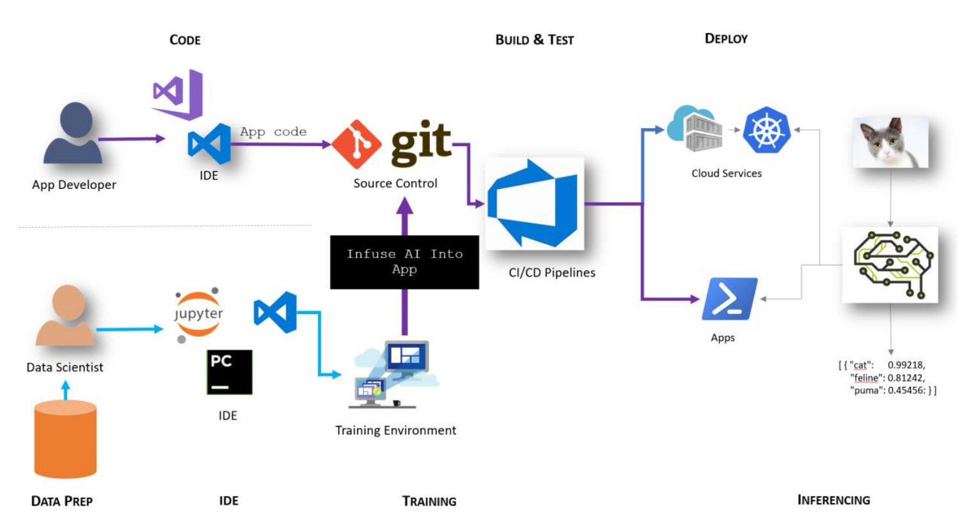
Step 1 – Infuse AI into App

Slide 49
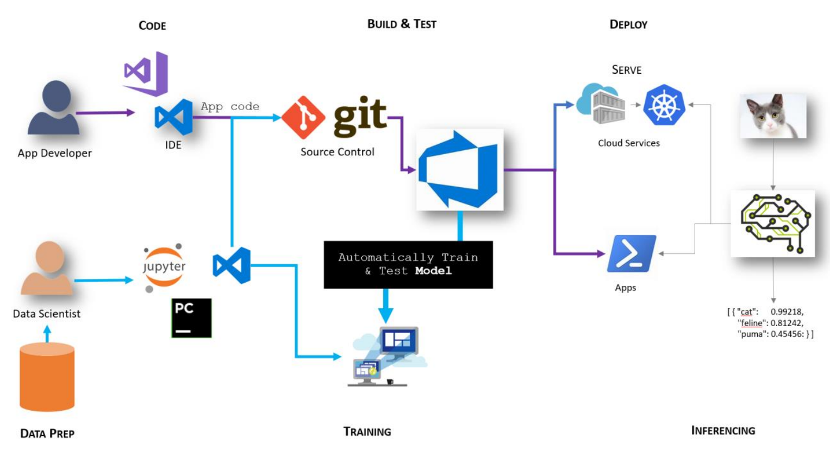
Step 2 – Automate Model Training

Slide 50
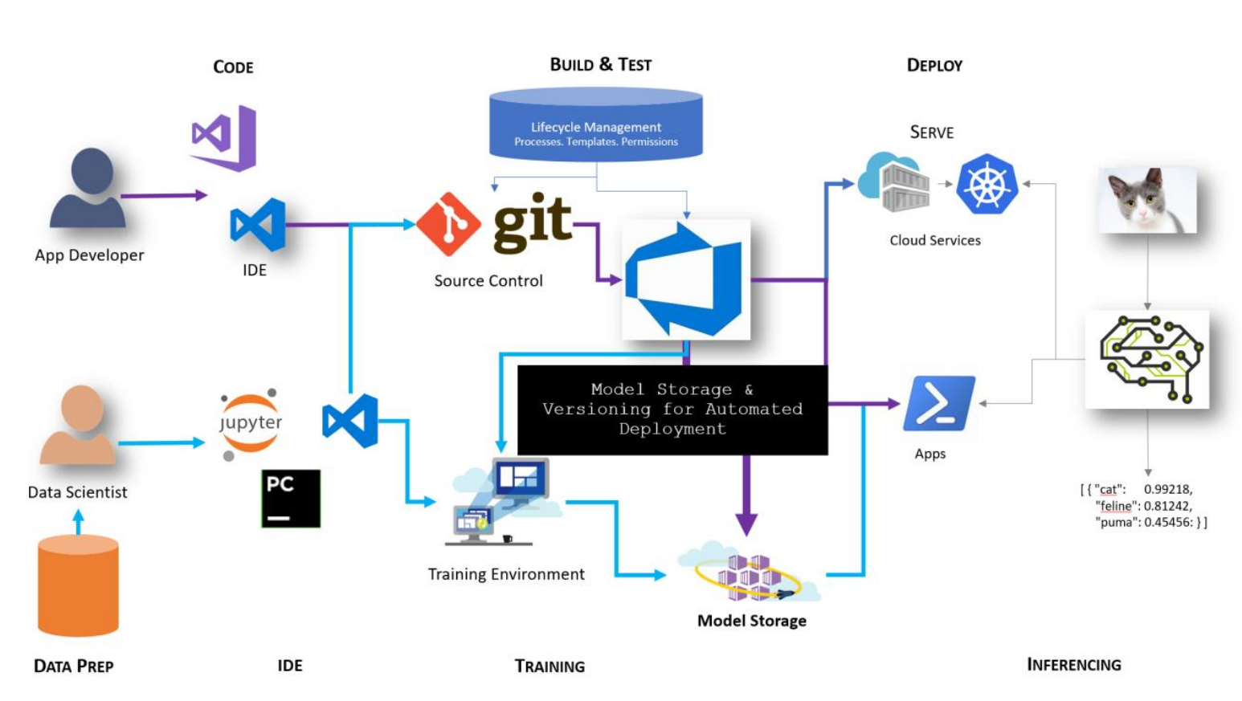
Step 3 – Store, Version and Validate Models

Slide 51
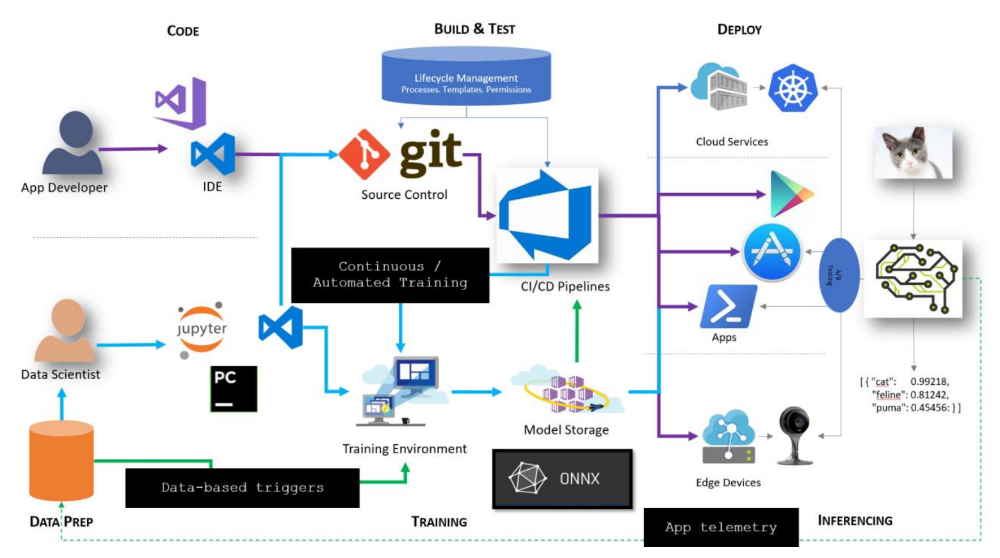
Step 4 – Automate Model Release
Notes:
Data prep needs to be versioned as part of training as well
Wrangling / training / inferencing
Ingress controller for routing
Traffic from k8s / aml is looking at istio
Confuse.com in UK
Open Neural Network Exchange

Slide 52
Example Scenario…
Developers write code locally and shares their work with their colleagues using Docker containers.
Use Docker to push their applications into a test environment and execute automated and manual tests.
When developers find bugs, they can fix them in the development environment and redeploy them to the test environment for testing and validation.
When testing is complete, getting the fix to the customer is as simple as pushing the updated image to the production environment.
https://docs.docker.com/engine/docker-overview/#docker-engine

Slide 53

Demos
Docker
Containers
Jenkins

Slide 54
0. Concepts introduction
Docker is a tool designed to make it easier to create, deploy, and run applications by using containers.
Jenkins is an open-source automation tool written in Java with plugins built for Continuous Integration purposes.
GitHub is a code hosting platform for version control and collaboration.
Continuous integration (CI) and continuous delivery (CD) embody a culture, set of operating principles, and collection of practices that enable application development teams to deliver code changes more frequently and reliably. The implementation is also known as the CI/CD pipeline.
Laravel is a free, open-source PHP web framework, created by Taylor Otwell and intended for the development of web applications following the model–view–controller (MVC) architectural pattern and based on Symfony.
Amazon Elastic Compute Cloud (Amazon EC2) is a web service that provides secure, scalable compute capacity in the cloud.
Amazon Relational Database Service (Amazon RDS) makes it easy to set up, operate, and scale a relational database in the cloud.
Unit testing is a software testing method by which individual units of source code — sets of one or more computer program modules.
Code coverage is a metric that can help you understand how much of your source is tested.
Static code analysis is a method of debugging by examining source code before a program is run.
Acceptance Testing is to assess whether the Product is working for the user, correctly for the usage.

Slide 55
References
“Secure DevOps Process and Implementation” Software Engineering Institute (SEI), Carnegie Mellon University, January 11, 2017, https://www.sei.cmu.edu/training/P116.cfm
https://en.wikipedia.org/wiki/DevOps
https://www.quora.com/What-are-the-more-efficient-combinations-of-Devops-tools-to-use-in-a-web-project
: https://www.sei.cmu.edu/education-outreach/courses/course.cfm?coursecode=V38

Slide 56

Questions?

